Slide 1







Presentation by Data_Titans
Serial No: - D49.
Forecasting Footfall Trends
:
A data driven Approach

Slide 2




Problem Statement
Our Approach
Our goal was to design and implement a machine learning model that predicts tourist arrivals at a specific destination using Internet search index as a key input. The goal of this competition is to develop an accurate and robust predictive model that can assist tourism authorities and businesses in forecasting tourist arrivals, thereby enabling better resource allocation, marketing strategies and overall destination management
We have approached the problem in 2 distinct ways. We have applied ARIMA model on each and every feature of the dataset(the search indices) to forecast their values and then using the XGBoost model to predict our total footfall based on the forecasted features. Another one is also an ARIMA model which has been directly applied on the total footfall to predict our future footfall.

Slide 3

Data Collection
In our data collection phase, we gathered vital information to fuel our forecasting models. This involved two key data sources:
Monthly Total Footfall Data
We diligently sourced monthly footfall statistics for two specific destinations(Himachal Pradesh and kerala) spanning from the year 2010 to 2022. These figures were obtained from a government portal, ensuring the reliability and accuracy of the data.
Google Search Index data
We obtained data from Google Trends on various search indices related to the tourism industry. This encompassed queries concerning tourist spots, travel agencies, train bookings, snowfall, roads, and weather of the spot. This data was also collected on monthly basis.

Slide 4
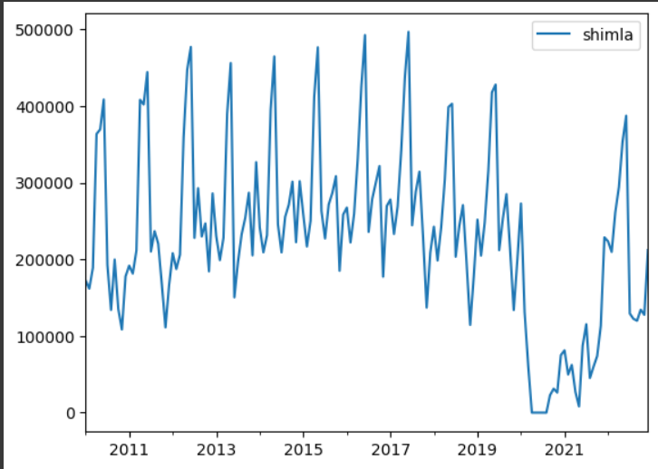
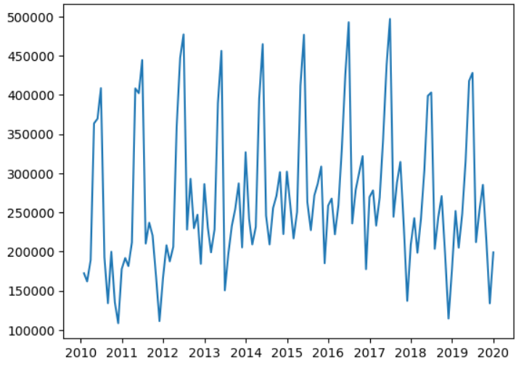
DATA TRENDS FOR SHIMLA
01
02
With covid time
Without covid time

Slide 5
Shortening the data
covid was an unexpected event. During the years 2020-2021, the footfall was significantly low. So it disturbs the actual trend and misleads the model. But just after covid time(2022 onwards), the same trend of the footfall is observed just as before. So we have removed the covid time data and trained our model over the data just before it.

Slide 6





Data Preprocessing
01
Data Loading
We utilised the powerful pandas library to load the CSV and excel files containing both the monthly footfall data and the Google Trends data into dataframes. This provided a structured format for subsequent analysis. By the footfall, we mean the total of domestic and foreign footfall.
02
Data Concatenation
To integrate the datasets effectively, we concatenated them utilizing the month as the primary index. This step ensured that the data was continuous for all months and ready for analysis.
03
Data Cleaning
Fortunately our dataset was in relatively clean state with no missing values requiring attention. This allowed us to proceed directly to modelling without extensive data cleaning efforts. We just removed the covid time datas.

Slide 7



Model Creation
Correlation of data w.r.t lag observation
ARIMA on each feature
XGBoost

Slide 8
ARIMA (Auto Regressive Integrated Moving Average)
ARIMA is a popular method for time series analysis and forecasting. This statistical technique that helps model and make predictions about time-dependent data. ARIMA models are useful when dealing with data that exhibits temporal patterns and serial correlation.
AutoRegressive (AR) Component: This component models the relationship between the current value of the time series and its past values. The "p" parameter represents the order of the autoregressive component, indicating how many lag observations are used to make predictions.
Example: AR(p) = φ1 * Y(t-1) + φ2 * Y(t-2) + ... + φp * Y(t-p)
Integrated (I) Component: This component represents the differencing of the time series data to make it stationary. Stationarity is crucial for ARIMA.
Moving Average (MA) Component: This component models the relationship between the current value and the past white noise (residual) terms. The "q" parameter represents the order of the moving average component, indicating how many lagged residuals are used in the model.
Example: MA(q) = θ1 * ε(t-1) + θ2 * ε(t-2) + ... + θq * ε(t-q)

Slide 9
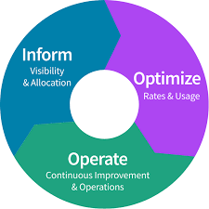
Model Improvement by XGBoost:
XGBoost, or Extreme Gradient Boosting, is a powerful machine learning algorithm for regression and classification tasks. It improves predictive accuracy by constructing an ensemble of decision trees and optimizing their performance, making it a popular choice for structured data. XGBoost's speed and regularization techniques make it widely used in various supervised learning applications.

Slide 10
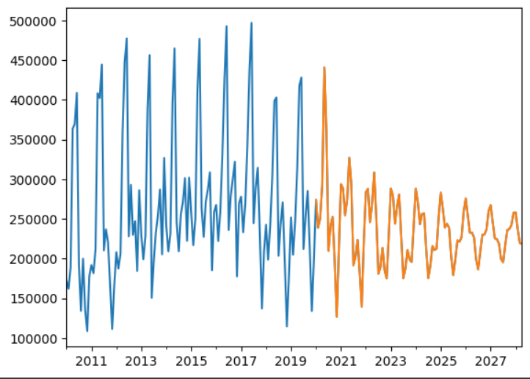
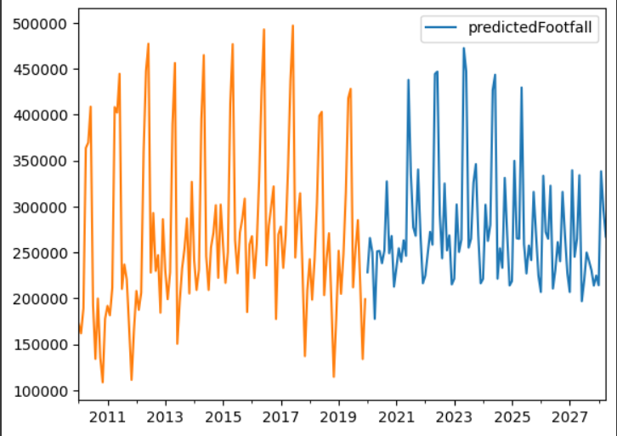
PREDICTIONS
01
02
Prediction with ARIMA directly on footfall
Prediction with ARIMA on each search index data coupled with XGBOOST
Orange: forecast
blue: forecast

Slide 11

ERROR ANALYSIS OF THE MODEL:-
Model, with Google search index-----
TRAINING NRMSE: 0.0114
TESTING NRMSE: 0.2134
Model with direct ARIMA applied on footfall-----
TESTING NRMSE:- 0.2684

Slide 12

Thank You
For Your Attention

